Slide 1


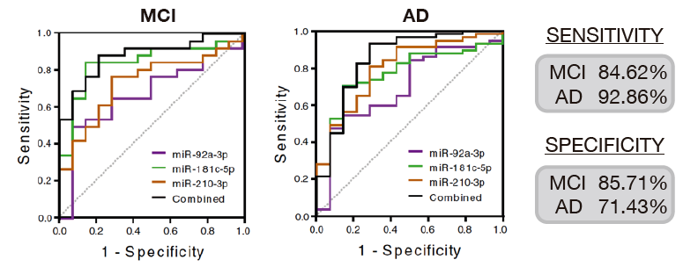
Technology Offer
CIRCULATING miRNAS AS BIOMARKERS FOR DIAGNOSIS OF MILD COGNITIVE IMPAIRMENT AND ALZHEIMER´S DISEASE
A research group is developing a cost-effective molecular kit based on the analysis of a miRNA signature as non-invasive blood-biomarker for early diagnosis of Alzheimer’s disease.
The Need
Recently, after years of efforts, a new treatment to fight against Alzheimer’s Disease (AD) has appeared, ADUHELMTM (aducanumab-avwa) from Biogen. Despite the generated doubts, it seems to delay AD progression. The current problem is to diagnose early and present biomarkers are expensive, time consuming and without the capacity to test everyone potentially elegible for aducanumab. An earlier diagnostic tool becomes more necessary.
The Solution
OUR ASSAY provides a feasible detection technique from obtaining a simple blood sample, miRNA extraction and qPCR using standard methods and equipment with easy results collection and interpretation. All that through non-invasive procedures, suitable for routine screening at a reference laboratory or hospital and with medical cost strongly diminished. Thus, we broad therapeutic window, reduce medical health cost and offer new possibilities for patients and caregivers.
Innovative Aspects
Our miRNA-based platform is designed to quick, specific and direct diagnose of early Alzheimer’s disease through a cost-effective protocol/assay for routine screening that could be implemented as a kit ready to be currently used in the analysis laboratories of hospitals worldwide. Our miRNAs signature has three major advantages:
a) Our molecular signature is targeting synaptic proteins and this is a relevant aspect since it is considered that synaptic dysfunction is an early event in AD development; b) We can differenciate between MCI subjects that will or will not develop AD, predicting MCI to AD transition and; c) Our molecular signature discriminate eAD among others forms of dementia.
We envision to develop a protocol/assay to detect our miRNA signature for routine screening that could be implemented as a kit to diagnose early AD. This devastating disease affects more than 50 million people worldwide and it is expected to reach 152 millions by 2050. Only one disease-modifying therapy exists (ADUHELMTM) and a large number of anti-AD drugs failed in clinical trials. Today, AD can only be clinically diagnosed at late stages when damage has already spread to several brain areas difficulting that therapeutic approaches could be effective.
Our miRNA signature will offer a tool to solve this problem, allowing an earlier diagnostic of AD at prodromal stages by using a simple blood sample collected as part of a routine check-up, samples can be processed at a reference laboratory or hospital using standard laboratory equipment.
Stage of Development:
Regulatory roadmap to validate our diagnostic assay with the requirements of regulatory authorities
Intellectual Property:
EP and US patent applilcation filed.
Aims
Looking for a partner interested in a license and/or a collaboration agreement to develop and exploit this asset.
Contact details
Consorcio Centro de Investigación Biomédica en Red
(CIBER)
otc@ciberisciii.es
https://www.ciberisciii.es/en

