Slide 1

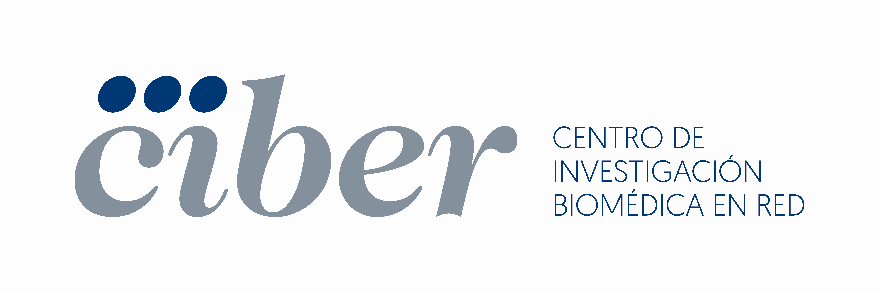
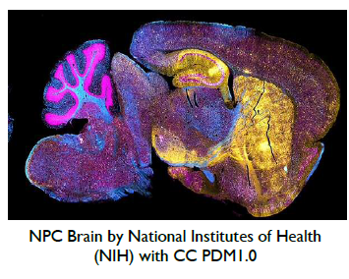
Technology Offer
Combined use of biotine and thiamine for prevention and treatment of Hungtington Disease
CSIC and the CIBERNED have determined that the combined administration of biotin and thiamine is capable of improving motor symptoms and reducing striatal atrophy associated with Huntington Disease (HD)
The Need
There is no cure or prevention for Huntington Disease (HD), nor is there a known way to stop the worsening of the disease. The average life expectancy is approximately twenty years from the first clinical manifestation. Although HTT lowering strategies currently in clinical trials are promising therapeutic strategies, they are challenged by limitations associated to efficacy of delivery of the gene therapy to the basal ganglia and toxicity issues. It is therefore important to elucidate the molecular mechanisms by which the triggering mutation elicits its toxicity as a way to find easily druggable targets.
The Solution
Through a detailed research of CPEB1 and CPEB4 protein expression the researchers have discovered a decrease in protein levels of the thiamine transporter (encoded by the SLC19A3 gene) in the striatum of subjects with HD, as well as the decrease in thiamine levels in the cerebrospinal fluid and in the brain of said subjects with HD. These results gave rise to think that a combination therapy with biotin and thiamine administration would be effective for HD patients, the goal of this treatment is to delay and reduce symptoms and help the persons suffering from the disease to fend for themselves for as long as possible.
Innovative Aspects
Efficacy of combined biotine and thiamine treatments is already proven for biotin-thiamine-responsive basal ganglia disease (BTBGD), and our results indicate that HD disease is in part a phenocopy of BTBGD due to a decrease in SLC19A3 protein levels.
Safety of the combined treatment is also granted given its use for BTBGD patients.
Easy administration and accessibility of the combined vitamin therapy to affected brain regions.
The main implication of our work is that it unveils a therapy that is easy to implement and is likely to improve the course of the disease, as visible improvements have been observed in the preclinical stage.
Furthermore, treatment with these vitamins has multiple advantages, such as safety and full accessibility to the central nervous system. In terms of safety, both biotin and thiamine are natural vitamins and are considered nutraceuticals approved by the FDA.
Stage of Development:
Phase II clinical assays (HUNTIAM assay)
Intellectual Property:
- United States (2022): US17/763,439
- European Patent (2022): EP20869839.9.
Aims
Looking for a partner interested in a license and/or a collaboration agreement to develop and exploit this asset.
Contact details
Consorcio Centro de Investigación Biomédica en Red
(CIBER)
otc@ciberisciii.es
https://www.ciberisciii.es/en

